Slide 1
Accelerate Innovation with APIs and Integration
Tom ainsworth
Account Executive UK/I, Nordics & South africa
📱: +44 (0) 755 314 9231
📧 : tom.Ainsworth@Jitterbit.com
Notes:
FOR FIRST CALLS ADD “ I want to thank you in advance for taking the time to learn about Jitterbit, our solutions and the market we serve. My one request as we start this process is that in the event that you determine that Jitterbit or fundamentally, iPaaS, is not a fit for XYZ Company that you simply let me know. As you will see we are a high growth company in a high growth market however not every company is in position to embrace this technology yet and I can assure you that we will understand and appreciate it of you tell me whether or not we should continue our conversations. Is that fair?"

Slide 2







The API Integration Company
Jitterbit
Market Validation
TARGET MARKET
INVESTORS
#1 in Customer Satisfaction
Leader in Enterprise Satisfaction iPaaS Magic Quadrant 5 Years in a Row
Upper Mid-Market, Lower Enterprise & Enterprise Cloud Adopters
Jitterbit by the Numbers
ENTERPRISE SCALE
TEAM
ALLIANCES
DATA LOADER
HARMONY
250+
Employees
300+
Partners
61,000+
Freemium Users
2,100+
Platform Clients
Notes:
Jitterbit is a global leader in iPaaS- integration platform as a service- enabling connectivity, integration and transformation of data from virtually any source or target system or API
We serve companies of all sizes, across all verticals all around the world
We are recognized and regarded across analyst and crowd-sourcing sites alike as one of the top vendors for technology delivery and THE top vendor for customer satisfaction which is demonstrated through both our net retention and growth metrics ( net retention is based on happy customers licensing more software versus customer attrition )
Finally, Jitterbit is backed by some of the most prestigious names in technology include KKR Ventures, salesforce and Samsung

Slide 3
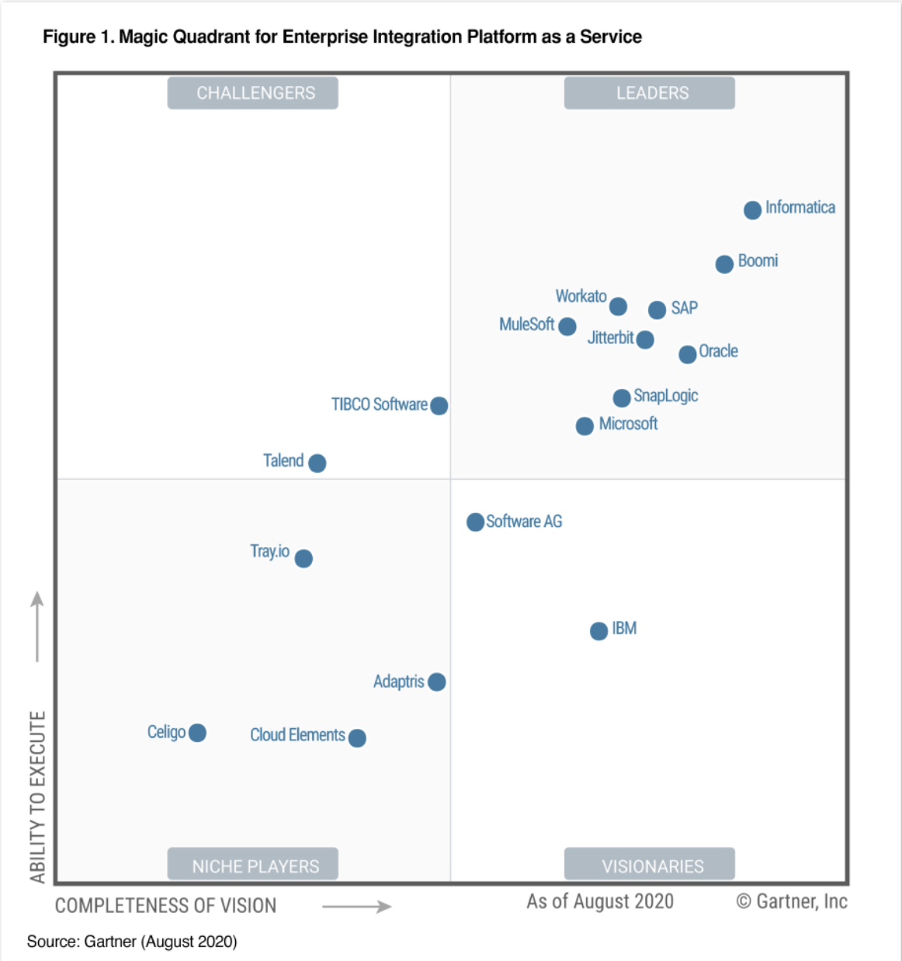
Jitterbit is in the Leaders quadrant of the Gartner Magic Quadrant for Enterprise Integration Platform as a Service 2020
Jitterbit Is A Magic Quadrant Leader 5 Years In A Row
100% of our customers responding recommended us and gave us a 5-star rating
Recognized by Gartner for 4 main things:
  Single Versatile API Platform
  “Value for Money and Time to Value”
  “Growing Customer and partner network globally”
  “Customer Relationships and Overall Satisfaction”
Notes:
Consistency is one of our hallmarks and we are rewarded with recognition such as being a perennial vendor in the leader quadrant for Gartner’s iPaaS Magic Quadrant and the only vendor to move up and to the right 4 years in a row.
We are recognized not just for the quality of our technology but more importantly for the success and recommendations of our customers- that is our ultimate reward

Slide 4

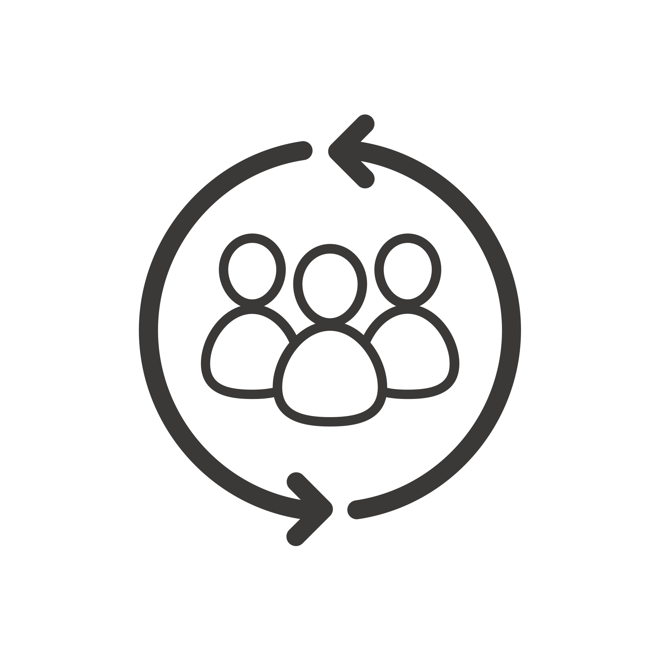


Mantra for Delivering Customer 360
For the Insurance Sector
People
(Customers, Brokers, Aggregators, Agents)
Systems
(Policy Admin, Claims, Billing, Reinsurance, Actuarial)
Departments
(Claims, Finance, Legal, Underwriting)
Processes
(Policies & Contracts, Claims, Billing)
Customer
360
Notes:
Per Gartner, fewer than 10 percent of companies have a 360-degree customer view, and only 5 percent are able to use this view to systemically grow their businesses. But those 5 percent definitely enjoy a competitive advantage.

Slide 5

Create a 360º view of your customers via Customer API360
Product Dev.
API
ML Insights
Customer
Segmentation
Policy Renewal
API
API
Marketing
CUSTOMER 360 roadmap
Renewals
Touchpoints &
Conversions
Leads
Status
Source
Customer
API360
Settlement
Submission &
Payments
Opportunities
Targeted Marketing
Claim Admin.
API
API
Distribution
API
Payments
Transactions &
Self-service
Insights
Risk evaluation
Policy Admin.
API
Shipments
API
Underwriting
API
Purchase & Onboarding
Notes:
The Customer API360:
Building a connected customer experience depends on the ability to capture, harness, and process data and insights across a complex landscape of applications.
Whether your customers are manufacturers, retailers, or technology providers, building the best possible customer experience requires visibility into the end to end customer journey (i.e.,, from Marketing to Sales to Distribution to Invoicing to Renewal) and this requires connecting disparate systems across your enterprise and sharing information within and outside your organization in an automated way.
At Jitterbit we believe in helping you create a Customer 360 through an integration platform that gives customers the ability to connect these disparate systems quickly and easily.
And to help accelerate the integration process even more, we’ve built (are building) packaged templates that have commonly used connections and processes already pre-built and ready to use right out of the box.
We can truly help your customers get the most out of their purchase of CRM/ERP/Ecommerce apps and help you close more deals and help you take them further up the staircase, as they continue to grow their NetSuite footprint.

Slide 6
Benefits of Driving Digital Transformation via Customer 360
56%
40%
36%
35%
Increase in
Revenue
Increase in
Operational Efficiency
Faster
Time to Market
Ability to Meet Customer Expectations
Sources:
1. Digital Transformation Survey, PTC
2. Gartner CEO Survey
Notes:
A recent survey conducted by Gartner that included 388 CEOs, 56 percent of them said that their digital transformation initiatives have already improved profits. These CEOs mentioned that they are driving a Customer 360 business model by aligning their customer, product, and service data to drive business growth via omni-channel e-commerce, digital marketing, and service innovation, among other technologies, while also embracing newer technologies such as the Internet of Things, or digital platforms and ecosystems.
In a separate research of 128 executives orchestrated by PTC, the top benefits of adopting a digital model to drive a Product 360 that were cited include:
a 40% increase in operational efficiency
a 36% improvement in time to market
a 35% improvement in ability to meet customer’s expectations

Slide 7
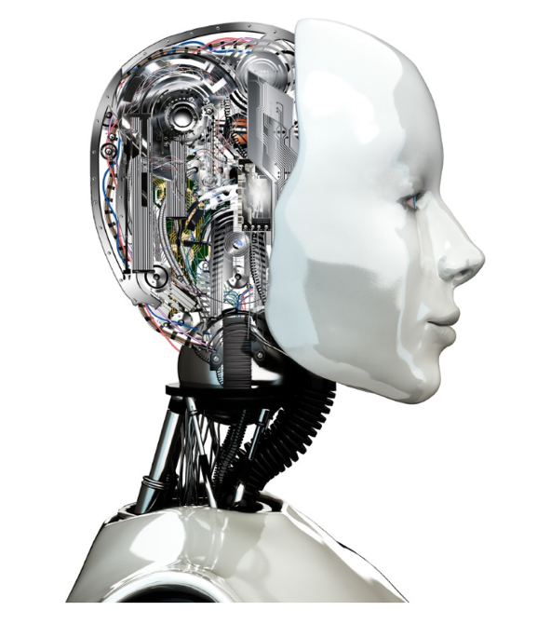





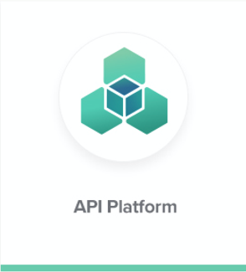
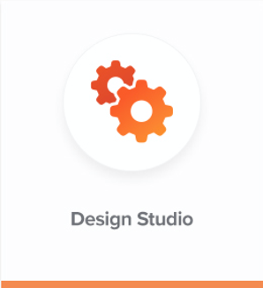
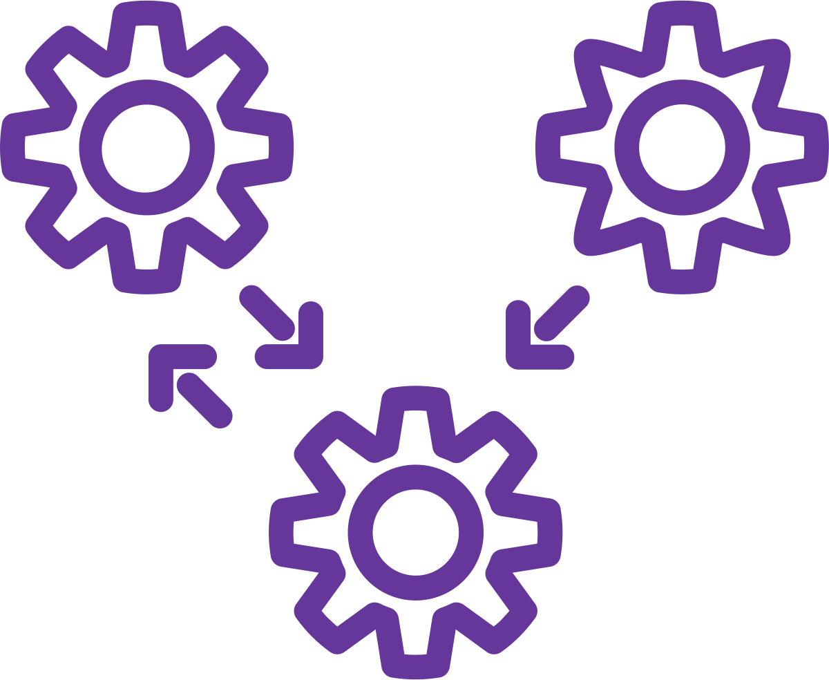

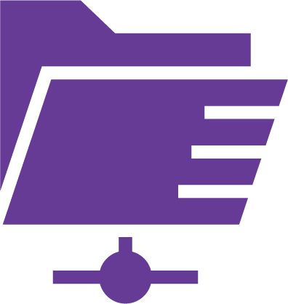

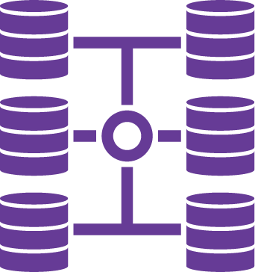





The Jitterbit API Integration Platform
Insurance Innovation
(Automation, Self-Service, Mobile, AI)
Jitterbit APIM™
(API Creation & Management)
API
API
API
API
API
Jitterbit Harmony™
(App Integration)
Legacy Mono-lithic Apps
FTP Flat
files
Packaged Enterprise Apps
Data Warehouse/ Virtualization
SaaS Apps
Web Services
IoT
Databases
B2B
Notes:
A recent survey conducted by Gartner that included 388 CEOs, 56 percent of them said that their digital transformation initiatives have already improved profits. These CEOs mentioned that they are driving a Customer 360 business model by aligning their customer, product, and service data to drive business growth via omni-channel e-commerce, digital marketing, and service innovation, among other technologies, while also embracing newer technologies such as the Internet of Things, or digital platforms and ecosystems.
In a separate research of 128 executives orchestrated by PTC, the top benefits of adopting a digital model to drive a Product 360 that were cited include:
a 40% increase in operational efficiency
a 36% improvement in time to market
a 35% improvement in ability to meet customer’s expectations

Slide 8


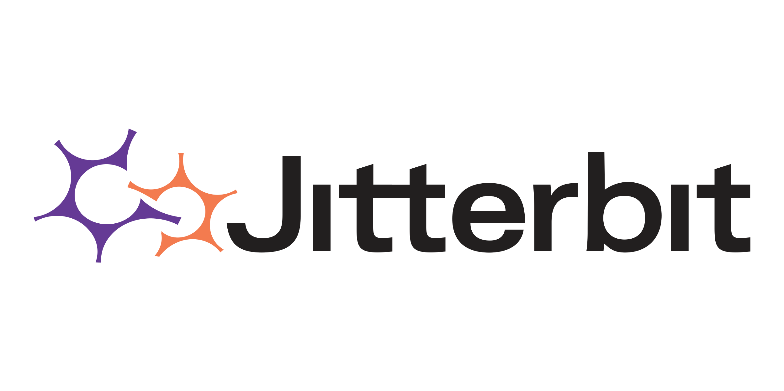

Semarchy – Jitterbit
2
Webhook Product
Push Notification
API
1
Update Fin. data
via Form
Update Journals
Harmony Platform
End User
4
Canonical Data Model
5
Dynamic ERP Routing
Update Accounts
IFRS 17 Calc. Engine
3
Pull Data from Semarchy
based on Accounts
Notes:
A recent survey conducted by Gartner that included 388 CEOs, 56 percent of them said that their digital transformation initiatives have already improved profits. These CEOs mentioned that they are driving a Customer 360 business model by aligning their customer, product, and service data to drive business growth via omni-channel e-commerce, digital marketing, and service innovation, among other technologies, while also embracing newer technologies such as the Internet of Things, or digital platforms and ecosystems.
In a separate research of 128 executives orchestrated by PTC, the top benefits of adopting a digital model to drive a Product 360 that were cited include:
a 40% increase in operational efficiency
a 36% improvement in time to market
a 35% improvement in ability to meet customer’s expectations

Slide 9

Mission
Empowering innovation and delivering exceptional experiences by connecting data, people, and processes.
Vision
To be the most sought-after partner, delivering best-in-class products and services connecting the world's systems.

